Slide 1


The Eclipse Plug-In Model
(characteristics, limitations, comparison & contrast to Backbone)
Andrew McVeigh, March 2008

Slide 2
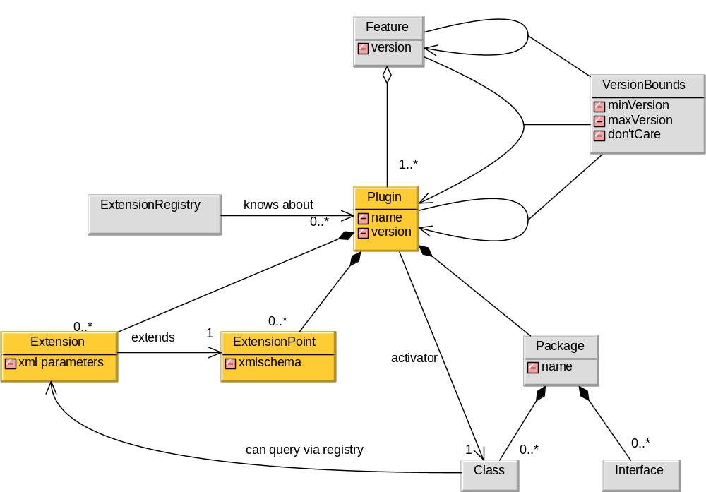
The Eclipse Plug-In Model

Slide 3
Points about the model
Extensions and extension points don't have to use classes
  Can just provide data/parameters to extension points
  But, a class can be a parameter (via name)
  Not possible to pass references!?
Plug-ins are like modules
  Implemented as OSGi bundles (a Java module spec) since 3.0
  Defines a life-cycle, with “sort of” dynamic behaviour (no quiescence)
  Also referred to as “components” -- i.e. define extension points etc.
  No nesting (although name may be used as per Java pkgs: org.eclipse.ui)
Plug-ins are implemented using classes
  Standard class model with inheritance
  Classes are notionally also a component construct in Eclipse
Eclipse is made of around 200 plug-ins (depends on version)
  WSAD is around 500 more!

Slide 4
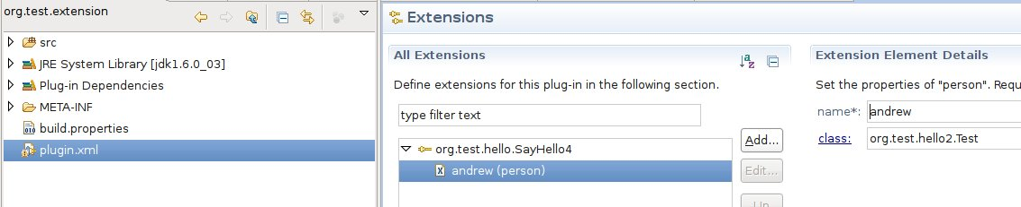
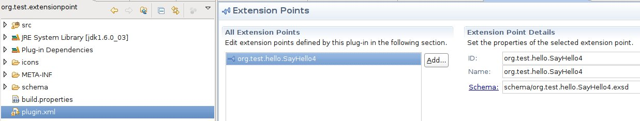
An Example
Extension project
extends
Extension point project

Slide 5
The Example Code
Extension just declares itself, no need to do anything special
Extension point must use registry to find all extensions
  awful, brittle, non-type safe code is required...
If schema changes, code may be looking for incorrect attributes
// find all the extenders of sayhello4
IExtensionRegistry registry = Platform.getExtensionRegistry();
IExtensionPoint pt = registry.getExtensionPoint("org.test.hello.SayHello4");
IExtension exts[] = pt.getExtensions();
for (int lp = 0; lp < exts.length; lp++)
{
IExtension ext = exts[lp];
IConfigurationElement[] config = ext.getConfigurationElements();
for (IConfigurationElement c : config)
{
try
{
System.out.println(“Name = “ + c.getAttribute(“name”));
Object obj = c.createExecutableExtension("class"));
}
catch (CoreException e)
{
e.printStackTrace();
}
}
}

Slide 6
What's clever about it?
The set of extensions is a function of the plug-ins loaded
  An extension point doesn't need to know in advance who extends it
  Can dynamically increase extensions as plug-ins are loaded dynamically
  (no caching)
plug-in B
environment
extension
dependencies
usage can be
both ways
(via interfaces)
plug-in A
extension point

Slide 7
Digging into Eclipse
(the architecture, and some scenarios)

Slide 8
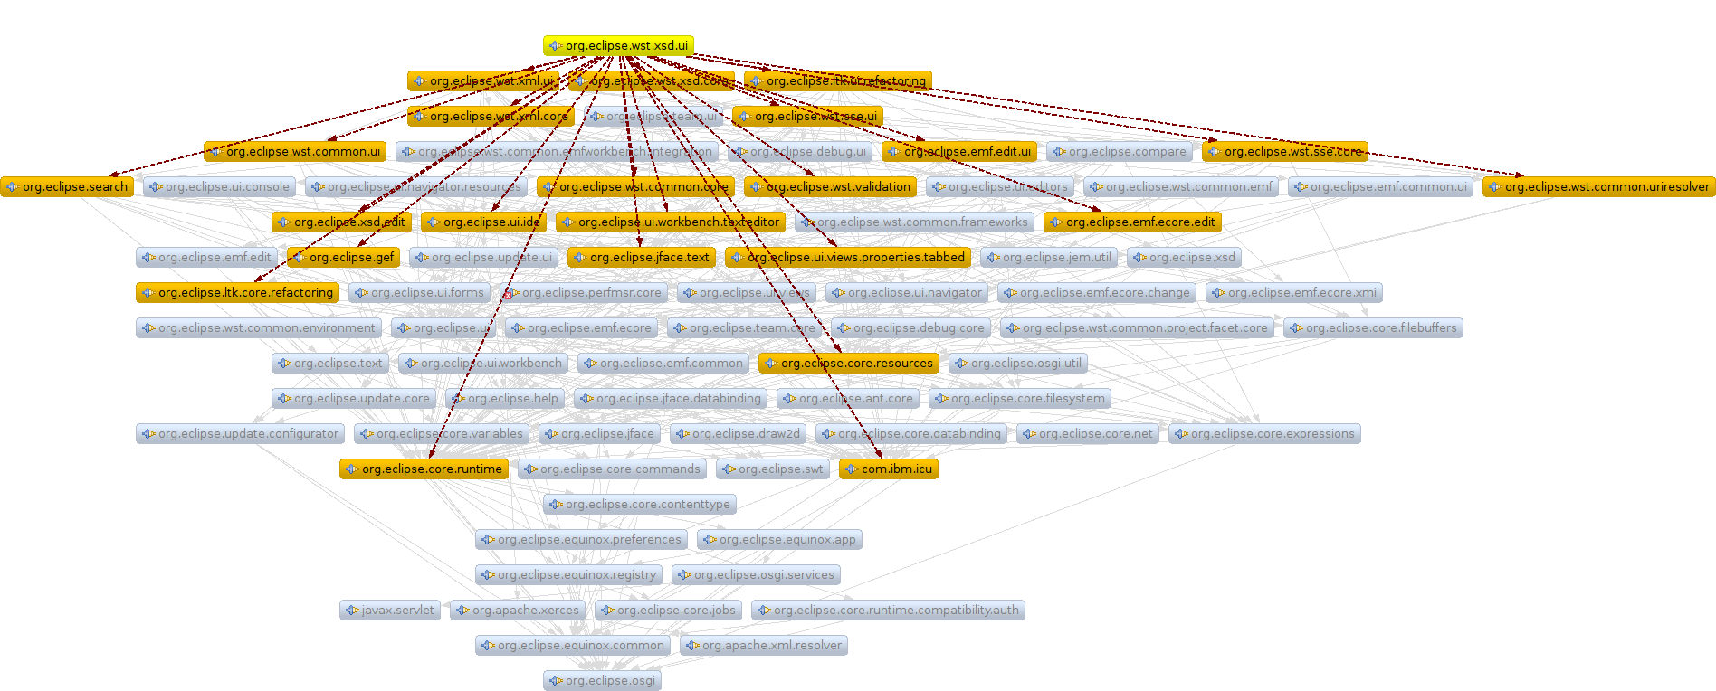

1st Attempt to Understand the
Overall Architecture of Eclipse 3.3
No nesting of plug-ins makes it hard to visualise
  This is approximately one half of the WST plug-ins (root = org.eclipse.wst.xsd)
    This is perhaps 1/8^{h} of the plug-ins size of an enterprise eclipse installation
    Multiple roots, full graph would be many-headed...
Moire pattern starting to form...

Slide 9
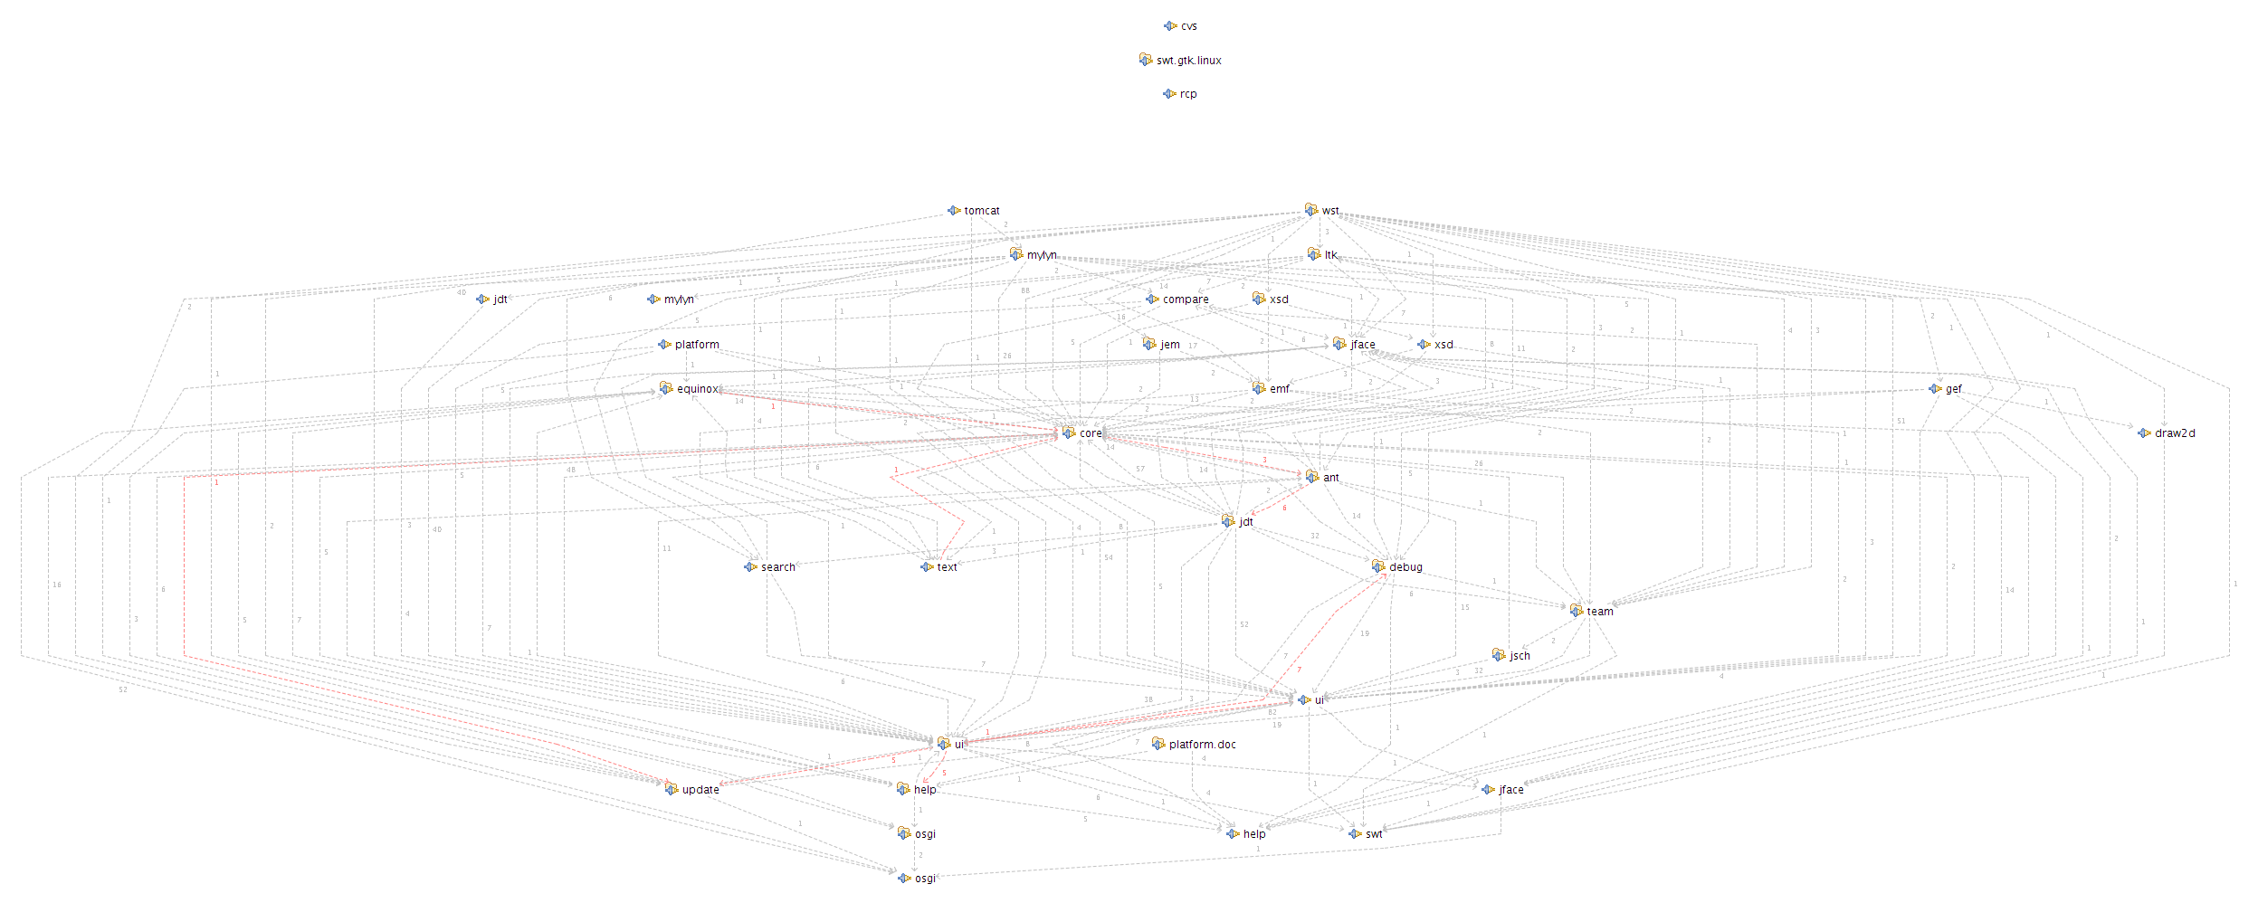
2nd Attempt...
Advanced tools have been “adapted” to understand Eclipse
  They are forced to assume composition via names
    E.g. org.eclipse is the parent of org.eclipse.ui
    But it doesn't really work like this (mail from Peter Kriens – OSGi is flat!)
E.g. org.eclipse partition is complex and misleading...
I ended up over time just ignoring the “bigger picture”
  Concentrate just on plug-ins that my plug-in uses. Not ideal...
(Diagram create by Structure101,
-- a tool for detecting Java package
and class dependency problems)

Slide 10
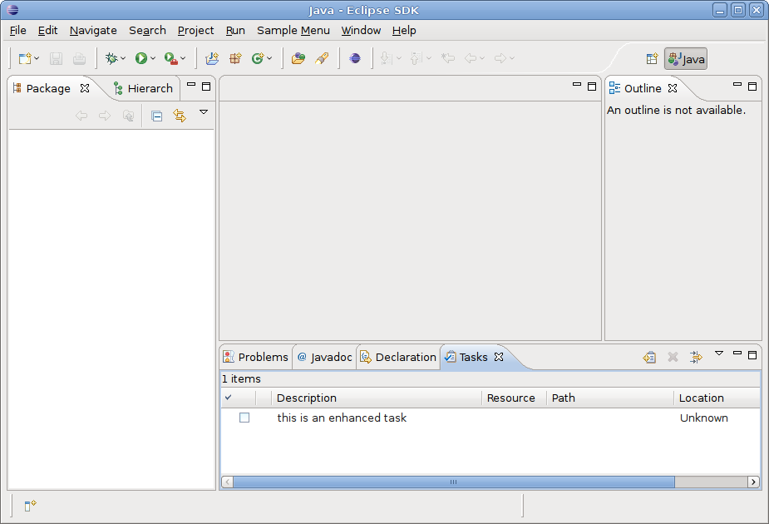
Simple Eclipse Extension Scenario:
Adding an “assigned to” column to the “Tasks” view”
Want extra column here...
Some tasks will contain “assigned to”, but most won't...

Slide 11
Adding the task is simple...
Create a plug-in, and add a button
  When clicked, button adds the task using the following “standard” extension code
Hardcoded global reference, ties code to the class name. May allow evolution, but prevents extension.
IWorkspaceRoot root = ResourcesPlugin .getWorkspace().getRoot();
IMarker marker = root.createMarker("org.test.base.enhanced-task");
marker.setAttribute(IMarker.MESSAGE, "An enhanced task");
marker.setAttribute("assignedTo", "Andrew");
Refers to separate XML configuration – dual representation + loss of type safety...
A hashmap under the covers!
Name-value pairs with no type safety are the oldest “generic” trick in the book

Slide 12
Adding the Column to the View?
There's a TaskView class in the org.eclipse.ui.ide plug-in
But, there's a problem
  – lots of hardcoding. E.g. fields, class names, UI actions...
The package is “internal”.
Should we not reference it?
Tying to a concrete subclass limits extension. Inheritance is bad for evolution
package org.eclipse.ui.views.markers.internal;
public class TaskView extends MarkerView
{
...
private final IField[] VISIBLE_FIELDS = {
new FieldDone(), new FieldPriority(), new FieldMessage(),
new FieldResource(), new FieldFolder(), new FieldLineNumber() };
Hardcoded field names/types. No pre-planned extension here...

Slide 13
Can We “Substitute” TaskView?
We need to replace the TaskView class
  But, there are further hard-coded references to the class
  E.g. The ActionDeleteCompleted class. If we replace, we must replace this also.
Hmm, it looks reasonably easy at first glance, but...
  No sub-classing possible due to final fields; low reuse
  So we need to copy and fork an EnhancedTaskView class
  The ActionDeleteCompleted instance is allocated in TaskView so we can replace this at the same time (if the name was further through the code it would be bad)
  Someone has helpfully planned for configuration of the task viewer by putting its creation in an extension...
<extension point="org.eclipse.ui.preferencePages">
<view
name="%Views.Task"
icon="$nl$/icons/full/eview16/tasks_tsk.gif"
category="org.eclipse.ui"
class="org.eclipse.ui.views.markers.internal.TaskView"
id="org.eclipse.ui.views.TaskList">
</view>
</extension>

Slide 14
Further problems...
To edit the “plugin.xml”, we need to evolve the entire plug-in!
  Eclipse plug-ins can only add, not replace or delete...
  To register our new version we must “fork” the code to a new version
  Current version is “3.3.2.M20080207-0800”
  Let's call our new version “3.4.0.enhanced”
If anyone depends directly on the current version, it's bad news!
  Get 2 instances of the plug-in: “3.3.2.M20080207-0800” and “3.4.0.enhanced”
  This won't work because we only want to have a single task viewer...
  The problem of shared state and the myth of running concurrent versions
Forking the plug-in works because the 1st version number indicates compatibility
  Conveniently all dependencies specify a version range
  from 3.2.0 to 4.0.0 exclusive (i.e. not 4.0.0) on this plug-in
  and we are able to keep the API of the TaskView backwards compatible

Slide 15
Result (sort of...)
We can update the TaskView, but only just
  We can't break the API or we will need to start replacing almost all plug-ins!!
  To change 3 files (20 lines?) out of several hundred files, we've had to fork the entire plug-in!
    What's the likelihood of the new version of Eclipse including my changes? ;-)
    Because of the class OO model, we can't reuse the old vn via subclassing anyway
    We may as well copy and fork the source for TaskView...
    In effect, I've branched the plug-in. The Eclipse foundation doesn't care...
  If anyone depended upon a single plug-in version, the whole scheme would break... Requires that people don't break any APIs until Eclipse 4.0.0.
  The change looks like it was planned for, at any rate!
    Should have been easy
    Change has been limited to “add” in order to prevent structural conflict and interference between plug-ins...

Slide 16
How Does the Plug-In Model Rate?
Comparing it to the requirements for reuse that drove Backbone
  Alter – It should be possible to alter a component/plug-in for possibly extensive
  new requirements
  NoImpact – The change should not impact existing users of the component
  NoSource – the approach should work without source code, as far as possible
  Upgrade – we should be able to accept upgrades to our modified component
It's possible, but we had to fork a large
code-base for a simple modification.
Copy and pasting doesn't
affect existing users who don't
want our change. We can't distribute though...
Needed the source code for a simple alteration
We'd have to do a source merge
with any other Eclipse update.
But we can't all use the same repository!
Score: poor. No wonder it's all so fragile...
At the base is copy / fork, a set of compatibility conventions and name / value pairs.

Slide 17
Summary of Issues
Plug-ins are non-hierarchical; no hiding of dependencies
  Full module dependencies are too complex to draw
Plug-ins are like modules and component combined
  Single component instantiation, extension points at module level
  No explicit connectors – makes it hard to visualise / reason about architecture
  Not enough in the model: I was looking at source code withing an hour of starting
Plug-ins tend to be opaque and brittle
  No recursive modeling approach.
  All the problems of class-based systems: inheritance, tight coupling to names, abstraction hiding problem, packages don't enforce dependencies etc.
Unplanned Extension = new version of plug-in
  Unit of modification is whole plug-in (editing source); very coarse grained
  Explicit version dependencies will require older plug-in to run concurrently
  Causes a “long version tail” and problems for plug-ins with shared state
  Sometimes even planned extension leads to new version!

Slide 18

Modeling the example with Backbone & Components

Slide 19
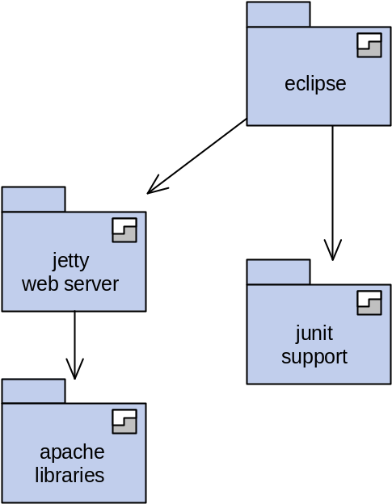
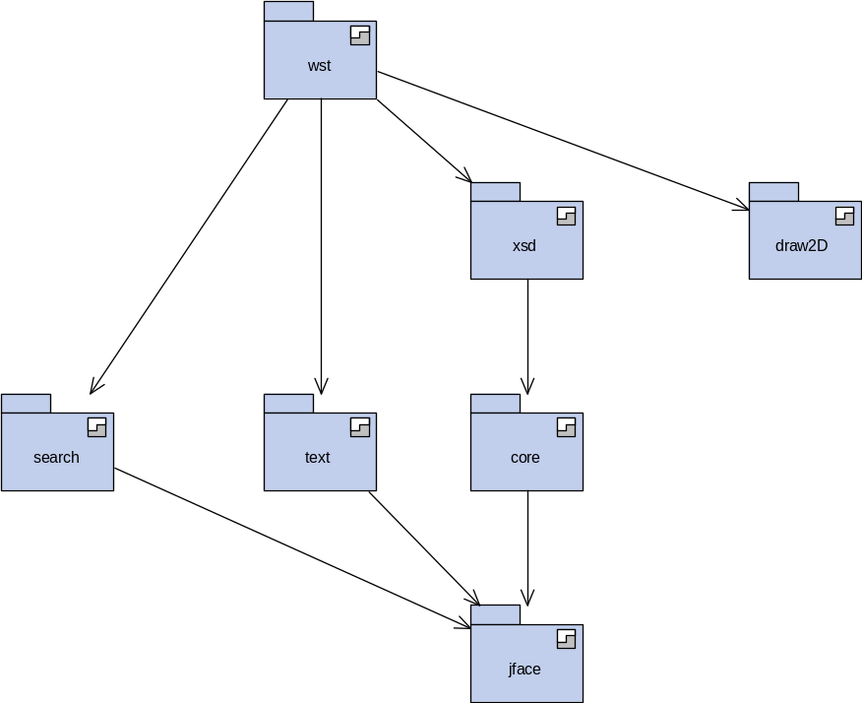
Solution 1: Hierarchical Stratum
The system can be presented in logical levels
  Enforces system discipline as well as aiding understanding
  Only recently added. I'm glad I did it after seeing the Eclipse mess...
  Advanced controls for visibility of nested strata
diving in gives
...
diving in gives

Slide 20
Solution 2: A Full Component Approach
Recursive design
  Aids understanding, enforces design discipline
  Multiple instantiation gives flexibility & reuse not given by plug-ins (single only)
Composites and factories keep component creation in the configuration
  Names are not hard-coded and can be replaced by substitution or resemblance
  Easy to see what will be created by looking at the model
  Have a consistent (and single) modeling approach
Decoupled components
  Insulated on the provide and require side by interfaces

Slide 21
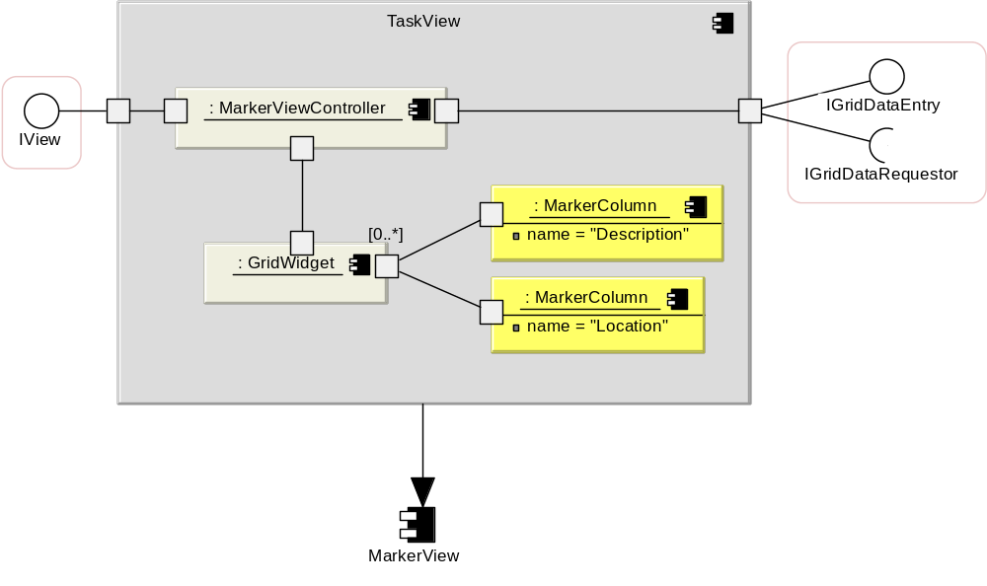
TaskView as a Component
Gets all its structure except the fields from MarkerView
“pushing” data at the grid can solve the name / value pair issue
  i.e. entry / requestor pattern...

Slide 22
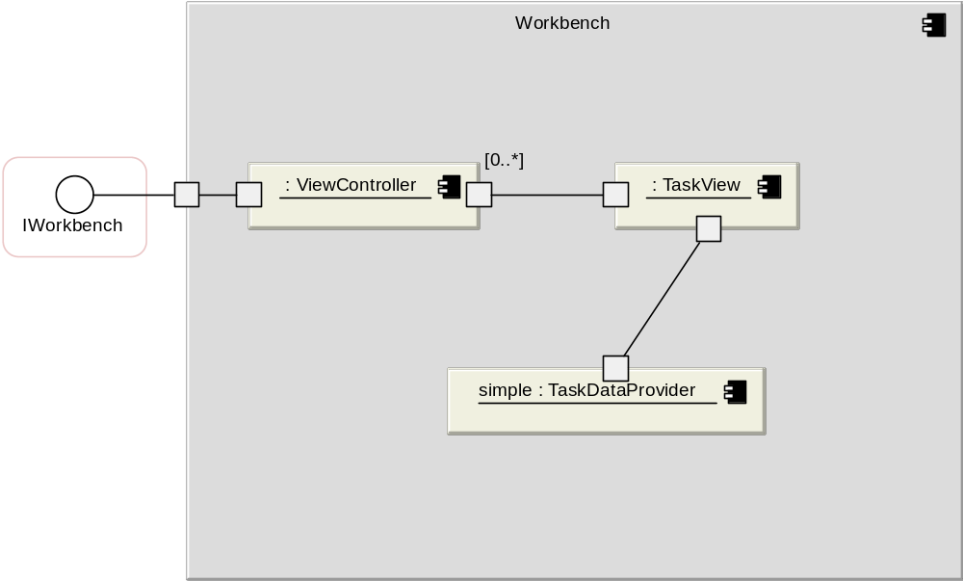
Creation of a TaskView
If lazy creation is required, simply use a factory
  The factory still will have a TaskView part allowing it to be altered for extension

Slide 23
Solution 3: Provide Change Constructs
Resemblance allows reuse with changes
Substitution allows evolution
Unplanned changes can be incorporated at low cost
  Every component, interface, port, part, connector, attribute is a place of potential extension
Changes kept as deltas
  Resolves the issue that the central owning body may not want my changes
  E.g. in task example – no way would Eclipse Foundation take my alterations.
    If I fork, I'm maintaining it forever... There's no way I can distribute this to clients.

Slide 24
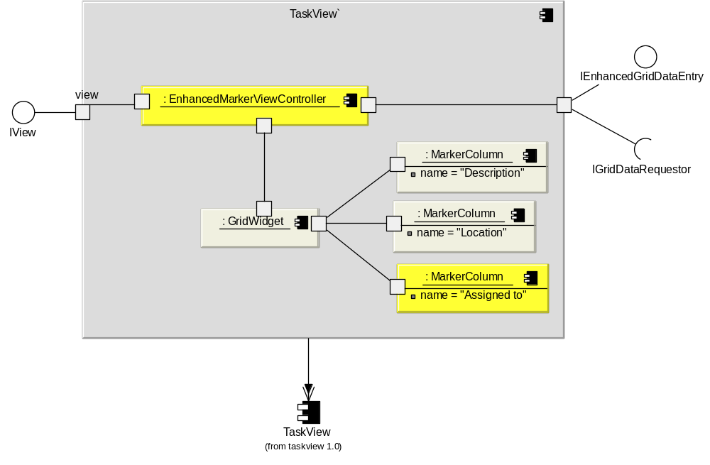
Evolving the TaskView
Substitute to add a new column and accept a superset of data

Slide 25
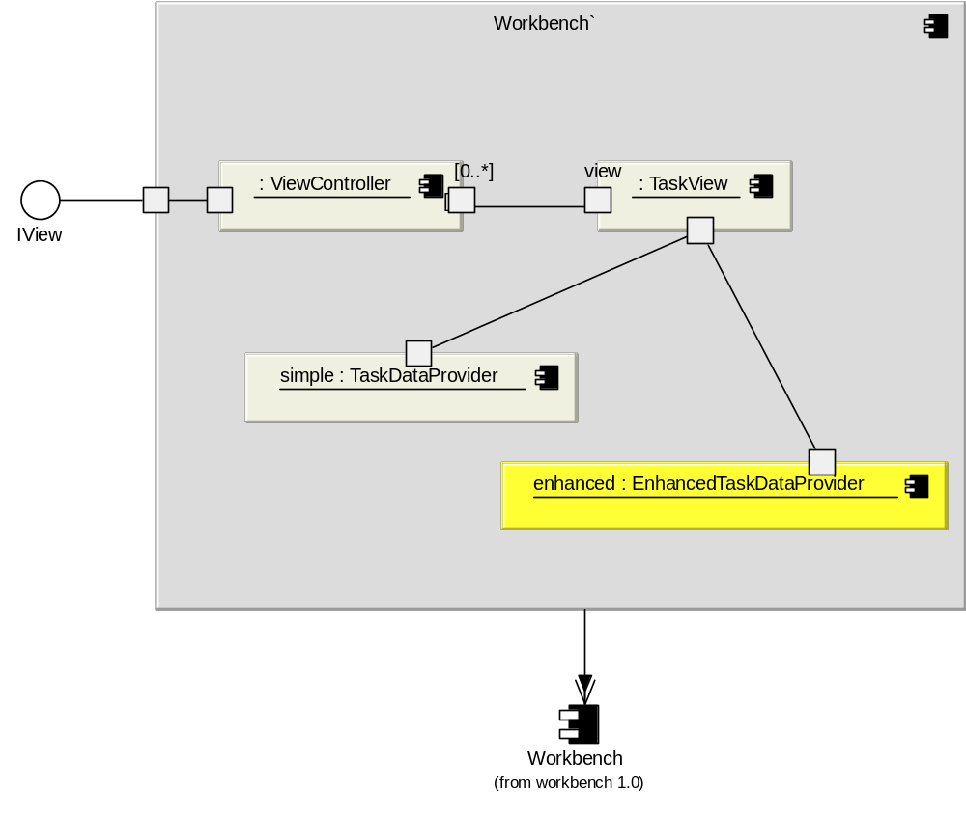
Adding Enhanced Task Providers

Slide 26
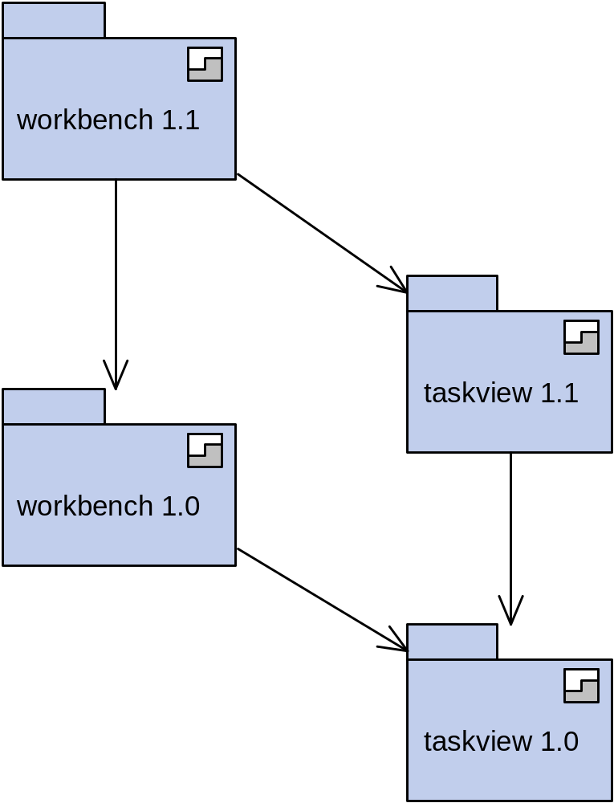
Packaging it up...
Changes were possible even though not necessarily planned for. It's a natural part of the model.
Deltas held here. Can pick up upgrades to 1.0 from other providers.
No source was required to make the changes, even though we reused much of the structure

Slide 27
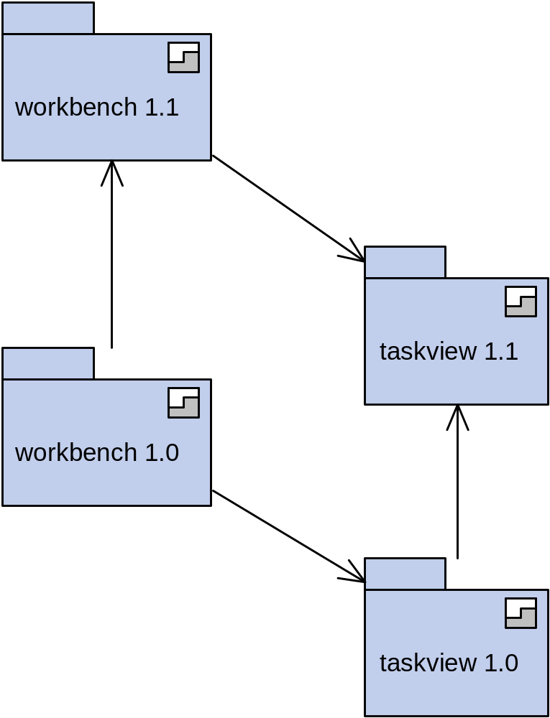
Baselining
Allows us to bunch up changes and get rid of older strata
  Also, the changes become reversed allowing us to reconstruct the old strata
We can now delete the 1.0 strata, or keep them around for people running older versions
No direct clients of 1.0 strata are affected, unless we want them to be

Slide 28
Summary
Backbone merges a component model & extension primitives
  No need for explicit extension points – extension is a natural part of the model
  As model gets naturally more granular, the “size” of the parts we need to replace becomes smaller and more targeted
In contrast to Eclipse plug-ins
  Doesn't require forking
  Has a natural modeling and architectural approach
  Is a component model, with a much richer approach to reuse
  Is not name sensitive – names can change via refactoring without breaking
  Allows a much wider range of extension and most things are alterable in proportion to the change required
  Can be analysed for interactions between independently-developed extensions

Slide 29

Backbone compared to Eclipse Plug-ins

Slide 30
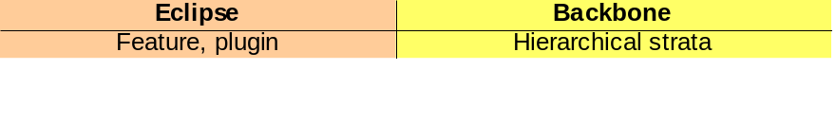
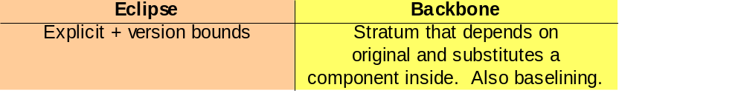
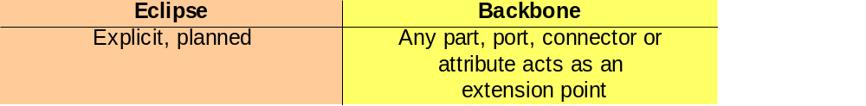

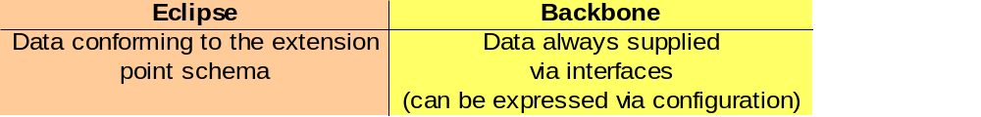
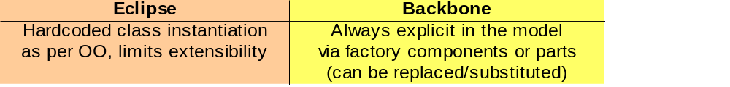
Approximate Correspondence...
Module concept
Component
Versioning of modules
Extension point
Extensions
Extension parameters / data concept
Object instantiation
Plug-ins cannot be multiply instantiated.
Classes can be instantiated more than once, but are coupled to extension points of their plug-ins.
Dependent versions might not be specified and may “slide”, causing issues
If explicit versions are used, brittleness & sharing problems result
Backbone can handle unplanned changes without modifying / forking the source
If the Backbone model is granular, the unit of change can be very small.
In Backbone the extension data is typed in the host language, and subject to normal Java typing rules.
Having types expressed via factories or parts allows them to be substituted later – unplanned extension

Slide 31
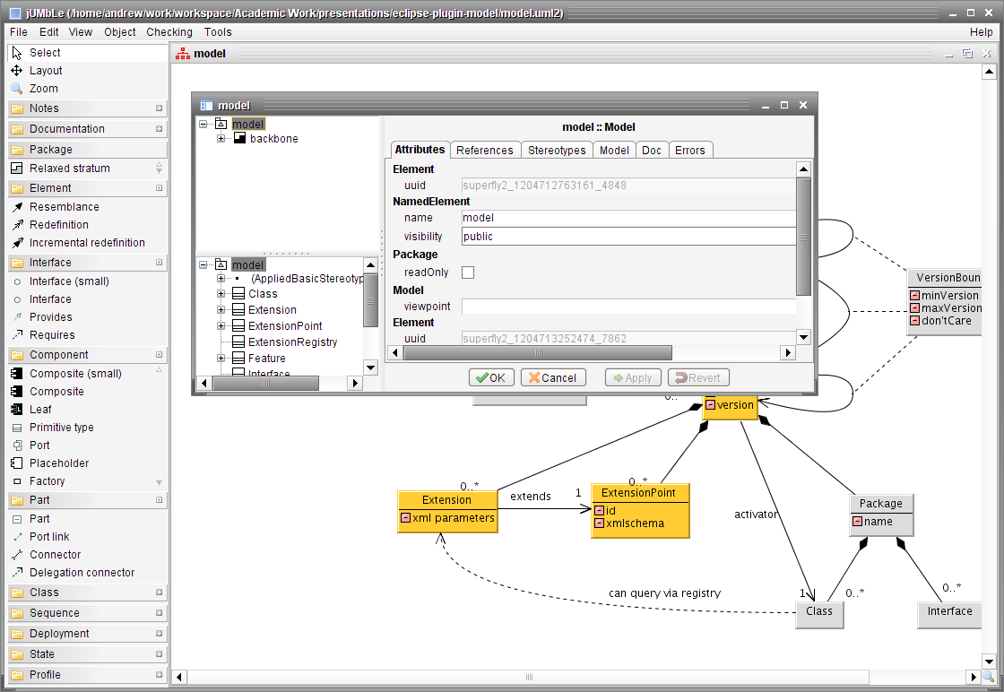
Implementation Progress
(where am I up to?...)

Slide 32
New Interpreter almost complete...
Based on common core with modeling tool
Full scalable, “combinatorial” error checker, with optimisations
Backbone
Interpreter
(JSON & objects)
Case tool
(Eclipse/UML,
xml, OODBMS)
DeltaEngine
Error Checker
Type inference
Component
model
Common
infrastructure

Slide 33
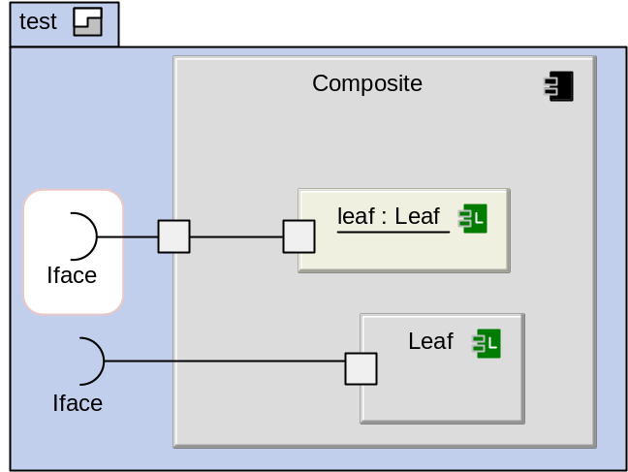
New Backbone format
{
Package:
{
name: test, uuid: superfly2_1204729116865_5430,
parent: model,
elements:
{
interfaces:
{
name: Iface, uuid: superfly2_1204729144167_8428,
implementationClass: com.test.Iface
},
components:
{
name: Composite, uuid: superfly2_1204729123662_1976,
kind: COMPOSITE,
childElements:
{
components:
{
name: Leaf,
uuid: superfly2_1204729134079_4269,
kind: LEAF,
implementationClass: com.test.Leaf,
ports:
{
uuid: superfly2_1204729139009_341,
requires: superfly2_1204729144167_8428
}
}
},
ports:
{
uuid: superfly2_1204729154557_2414
},
parts:
{
name: leaf, uuid: superfly2_1204729157817_6839,
type: superfly2_1204729134079_4269
},
connectors:
{
uuid: superfly2_1204729171297_9533,
fromPort: superfly2_1204729154557_2414,
toPort: superfly2_1204729139009_341,
toPart: superfly2_1204729157817_6839
},
}}}}
JSON
(Javascript object notation)
  Can also generate / accept XML
  Parser and generator are already
  fully implemented
  Can possibly be embedded in Spring XML
  for 2nd case study...
  Hopefully readable and concise enough
  for examples in papers, though...

Slide 34
Next Steps
Flattening
  Should be far easier this time, as connector model is simpler
Handling factories and indices
Stereotypes
  At the heart of the approach to “reduce design overhead”
Going (sort of) according to the plan described 2 months ago...

